Slide 1
Software configuration management (isb42303)
ID Number | Student Name
52213116280 | MUHAMAD FAIZ BIN HISHAMMUDDIN
52213116286 | AFIQ IZZUDDIN BIN MOHAMAD BUKHAREE
52213116044 | SYED ZARUL ZAQUAN BIN SYED MUHAMAD ZULKIFLI
52213116292 | WAN MOHAMAD NAIMAN BIN WAN MAYU OTHMAN

Slide 2
Question 1
Browse the Internet and find any standards related to "Software Configuration Management" and examine the standards and templates accessible over the web. Decide the document features, content, procedures, structure, and sections.

Slide 3
Question 1
IEEE Standard for Software Configuration Management Plans - IEEE Std 828™ 2005
Document Features
IEEE Std 828™-2005
Sponsor: Software Engineering Standards Committee of the IEEE Computer Society
Approved:
31 May 2005 by American National Standards Institute
14 February 2005 by IEEE-SA Standards Board

Slide 4
Question 1
Content
1. Overview
2. Definitions and acronyms
2.1 Definitions
2.2 Acronyms
3. The Software Configuration
Management Plan
3.1 Introduction
3.2 SCM management
3.3 SCM activities
3.4 SCM schedules
3.5 SCM resources
3.6 SCM plan maintenance
4. Adapting the plan
4.1 Upward adaptation
4.2 Downward adaptation
4.3 Format
5. Conformance to the standard
5.1 Minimum information
5.2 Presentation format
5.3 Consistency criteria
5.4 Conformance declaration
Annex A (informative) Bibliography
Annex B (informative) Relationship of IEEE 828-2005 to other standards
B.1 Relationship of ISO/IEC 12207 to IEEE/EIA 12207
B.2 Consistency of IEEE 828-2005 with IEEE/EIA 12207.0 and ISO/IEC TR-19759
B.3 Correlation
B.4 Document compliance

Slide 5
Question 1
Procedures
The allocation of SCM activities to organizational units shall be specified. For each activity listed within SCM activities, the name of the organizational unit or job title to perform this activity shall be provided. A matrix that relates the organizations defined above to the SCM functions, activities, and tasks can be useful for documenting the SCM responsibilities.
For any review board or special organization established for performing SCM activities on this project, the Plan shall describe its
a) Purpose and objectives;
b) Membership and affiliations;
c) Period of effectivity;
d) Scope of authority;
e) Operational procedures.

Slide 6
Question 1
Structure and Sections
Overview
Definitions and acronyms
The Software Configuration Management Plan
Adapting the plan
Conformance to the standard
Annex A (informative) Bibliography
Annex B (informative) Relationship of IEEE 828-2005 to other standards

Slide 7
Question 2
Browse the Internet with the search terms "Software Configuration Management Plan" and examine sample plans and templates accessible over the web.

Slide 8
Question 2
IEEE Standard for Software Configuration Management Plans - IEEE Std 828™ 2005
Document Features
IEEE Std 828™-2005
Sponsor: Software Engineering Standards Committee of the IEEE Computer Society
Approved:
31 May 2005 by American National Standards Institute
14 February 2005 by IEEE-SA Standards Board

Slide 9
Question 2
Content
1 Identification
1.1 Document overview
1.2 Abbreviations and Glossary
1.2.1 Abbreviations
1.2.2 Glossary
1.3 References
1.3.1 Project References
1.3.2 Standard and regulatory
References
1.4 Conventions
2 Organization
2.1 Activities and responsibilities
2.1.1 Decisions process and Accountabilities
3 Configuration identification
3.1 Identification rules
3.1.1 Identification rules of configuration items
3.1.2 Identification rules of SOUPs
3.1.3 Identification rules of documents
3.1.4 Identification rules of a media
3.2 Reference configuration identification
3.3 Configuration Baseline Management
4 Configuration control
4.1 Change Management
4.2 Interface Management
4.3 Evolutions control of SOUP items
5 Configuration support activities
5.1 Configuration Status Accounting
5.1.1 Evolutions traceability
5.1.2 Setting up Configuration status
5.1.3 Configuration status diffusion
5.1.4 Configuration status records storage
5.2 Configuration audits
5.3 Reviews
5.4 Configuration management plan maintenance

Slide 10
Question 2
Procedures
The allocation of SCM activities to organizational units shall be specified. For each activity listed within SCM activities, the name of the organizational unit or job title to perform this activity shall be provided. A matrix that relates the organizations defined above to the SCM functions, activities, and tasks can be useful for documenting the SCM responsibilities.
For any review board or special organization established for performing SCM activities on this project, the Plan shall describe its
a) Purpose and objectives;
b) Membership and affiliations;
c) Period of effectivity;
d) Scope of authority;
e) Operational procedures.

Slide 11
Question 2
Structure and Sections
Overview
Definitions and acronyms
The Software Configuration Management Plan
Adapting the plan
Conformance to the standard
Annex A (informative) Bibliography
Annex B (informative) Relationship of IEEE 828-2005 to other standards

Slide 12
Question 3
Research the literature and Internet. Identify FIVE (5) Open Source Software Configuration Management Tools.

Slide 13
Tools : CFEngine
pros
cons
High availability
High scalable (5000 agents per HubHub)
Highly secure (20 years of outstanding security record)
Extremely cheap on resources and fast (CPU, Memory)
Documentation is very difficult to understand where to start the new installation
Configuration is very complex
Not good with integrity checkers

Slide 14
Tools : PUPPET
pros
cons
Has strong compliance in automating and reporting tools
Provides active community support across development tools
Provides intuitional web UI to handle multiple tasks, which includes reporting and real-time node management
Initial understanding could be tough for new users who should learn Puppet DSL or Ruby, as advance and real-time task eventually requires input from CLI
While installing Puppet process lacks adequate error messaging.
support is more priories toward Puppet DSL over pure Ruby versions
Lacks revert system, so there is no immediate action on changes

Slide 15
Tools : chef configuration tools
pros
cons
follows the Push model and allows cloud adoption.
helps to increase service resiliency, to develop more defect-free software as it captures bugs before they occur
Helps to improve risk management. Chef’s automation abilities are able to lower risk and improve compliance at all stages of development
Chef tool is forced into Ruby
some workflows in Chef seem a bit convoluted as code bases become huge
The chef doesn’t support the push functionality

Slide 16
Tools : ansible
pros
cons
Ansible is based on SSH, so it doesn’t require to install any agents on remote nodes.
Ansible playbook structure is easy and crystal clear structured.
has a more streamlined code base compared to some other tools.
It has high interoperability.
less effective than other tools which are based in other programming languages.
does its logic modification through the DSL, that means checking in on the documentation consequently until you learn it
In ansible variable registration is asked for even simple functionalities, which converts easier tasks into more complicated
Ansible introspection is really very poor, so it makes tough to see the values of variables within the playbooks.
Poor development testing.

Slide 17
Tools : saltstack
pros
cons
It is simple, Straight and usage is easy once you go through the setup phase.
has DSL feature so it doesn’t require logic and states.
Saltstacks Input, output, and configs are very stable and consistent because it uses the concept of YAML.
Introspection feature plays a handy role as it makes simple to look at what is happening inside Salt.
The first installation process is really difficult to set up and make tough to for new users to understand.
Support for non-Linux Oss is not that great.
Refer Below Screen Shot of SaltStack

Slide 18
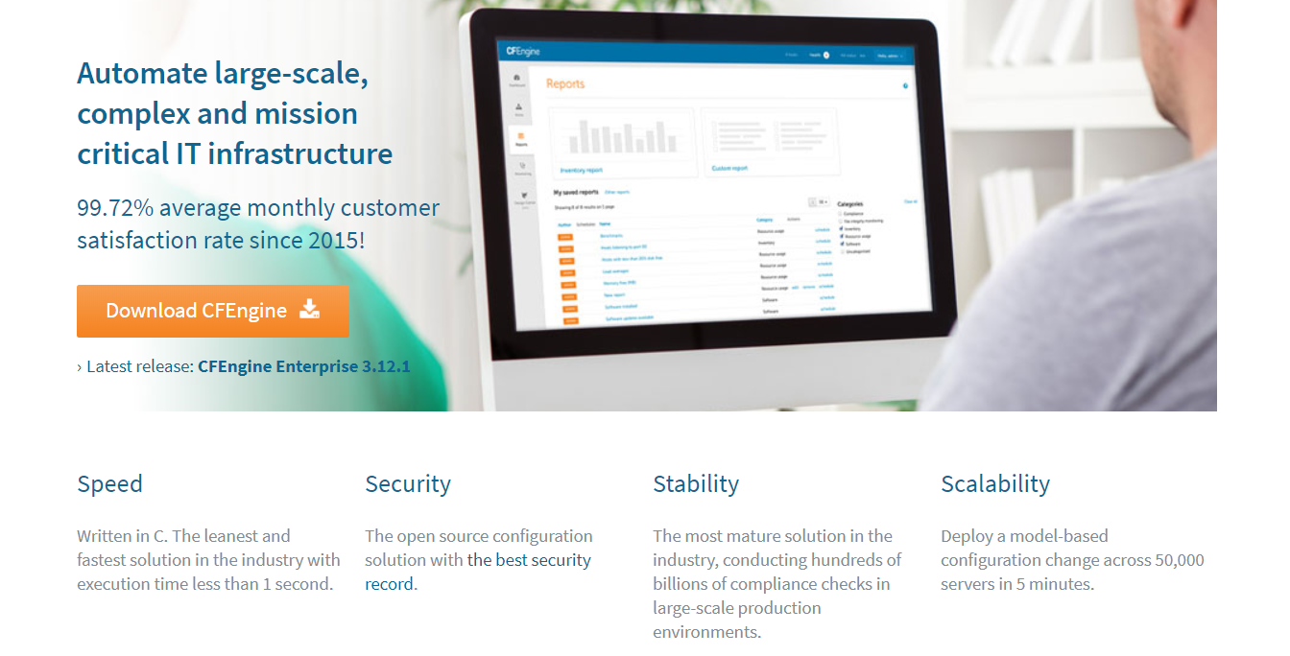
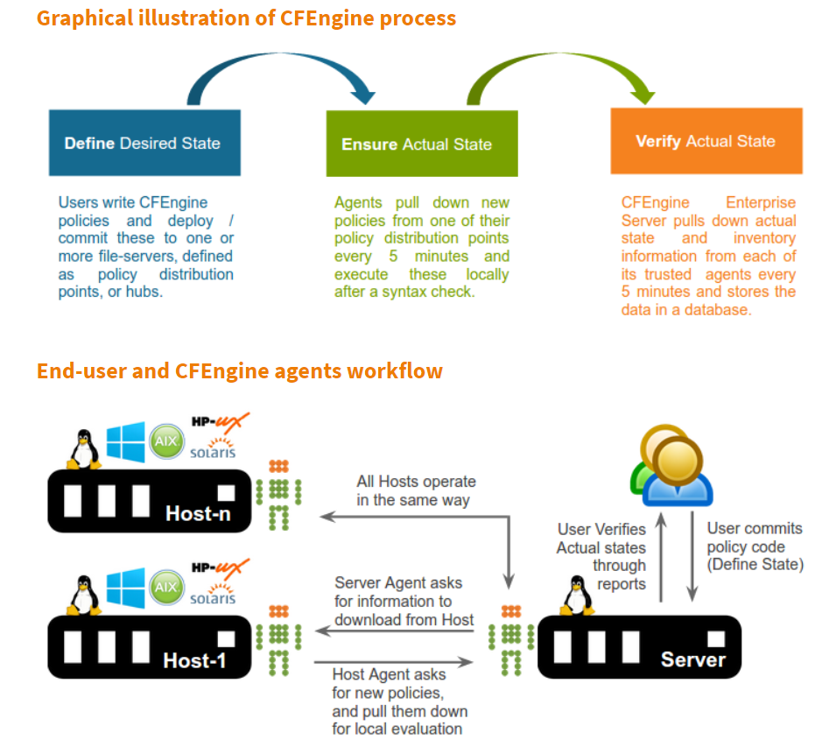
CFEngine

Slide 19
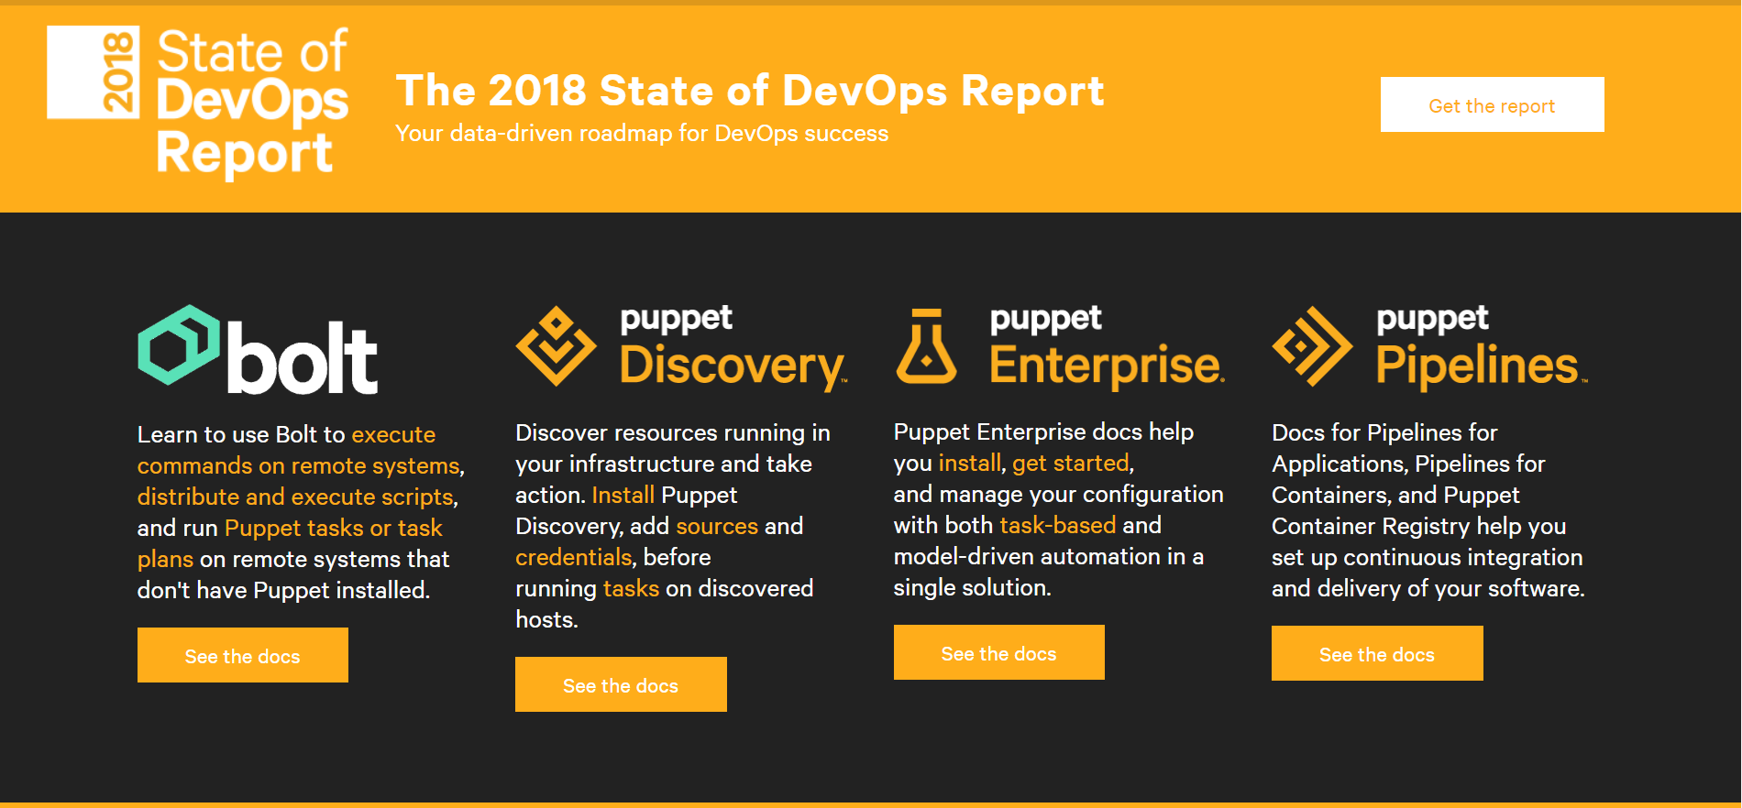
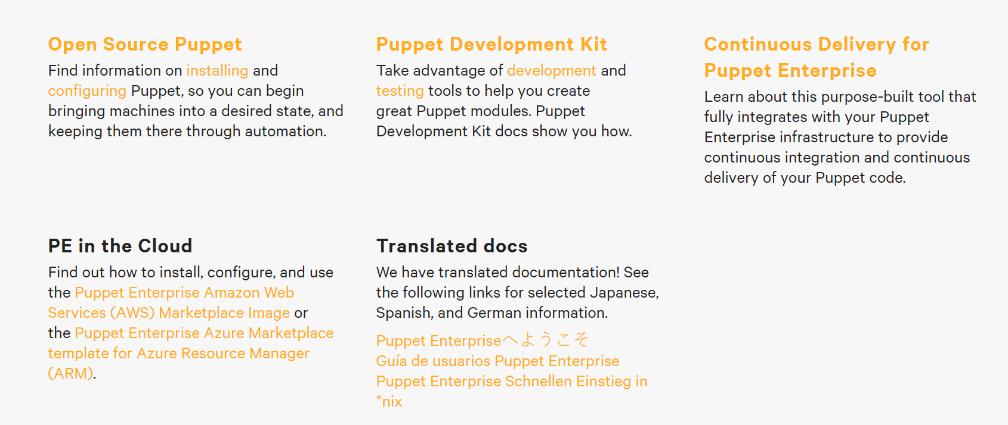
PUPPET

Slide 20
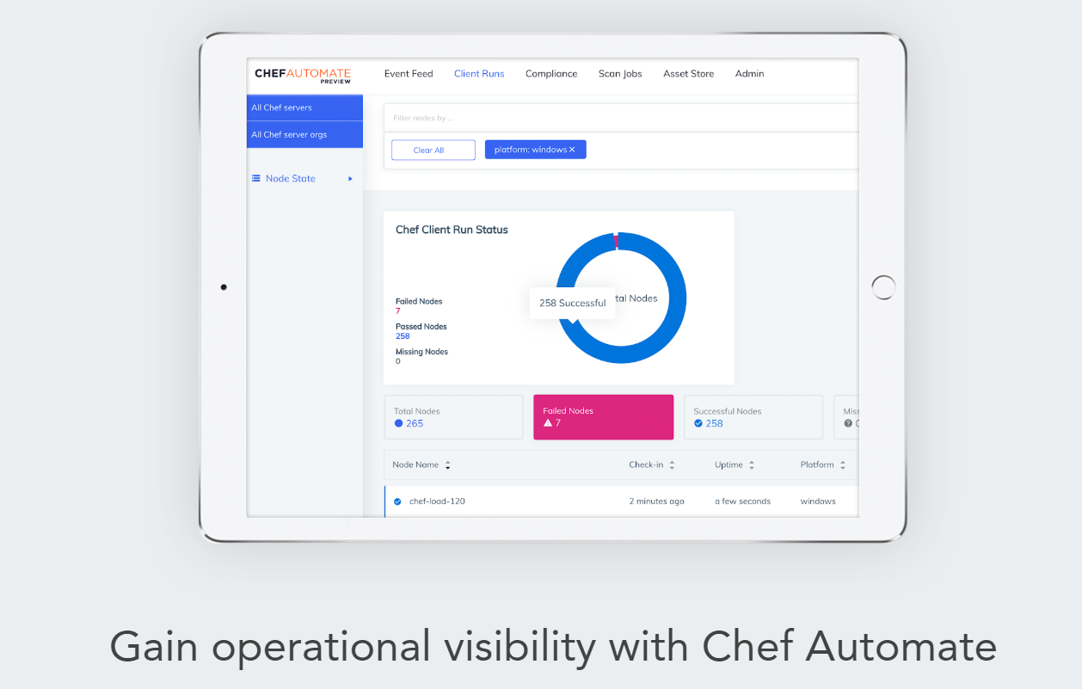
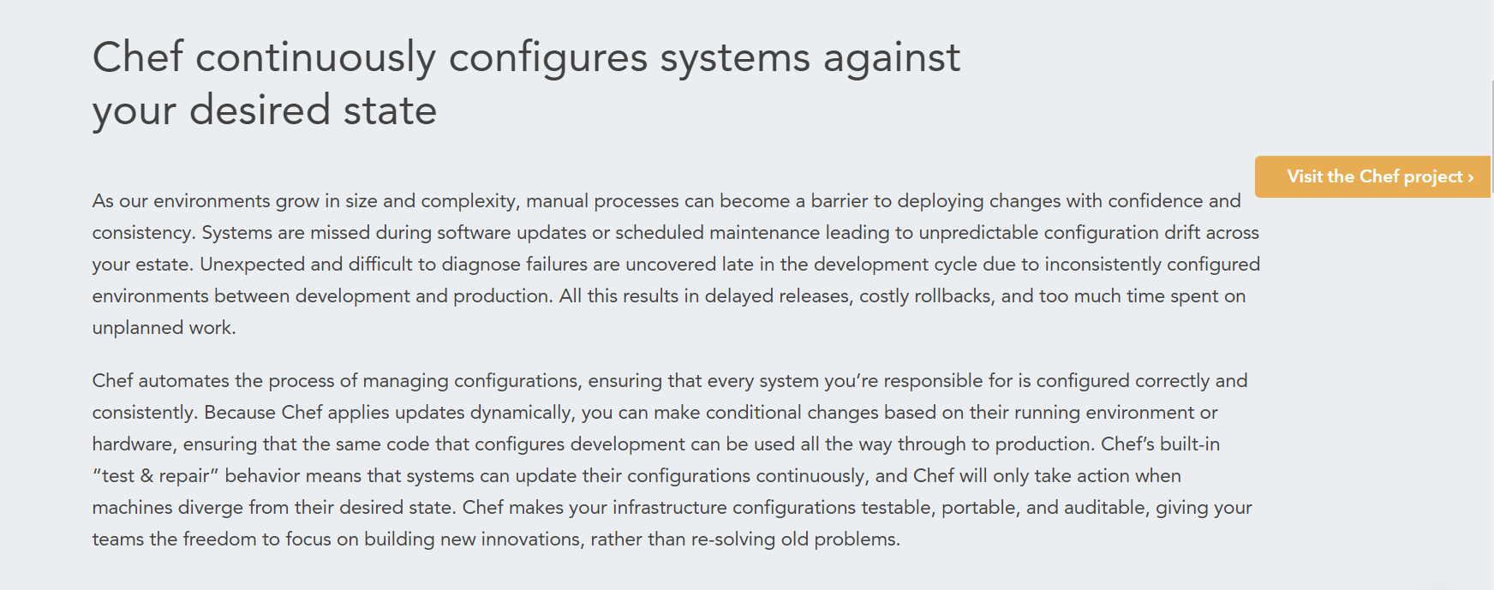
chef configuration tools

Slide 21
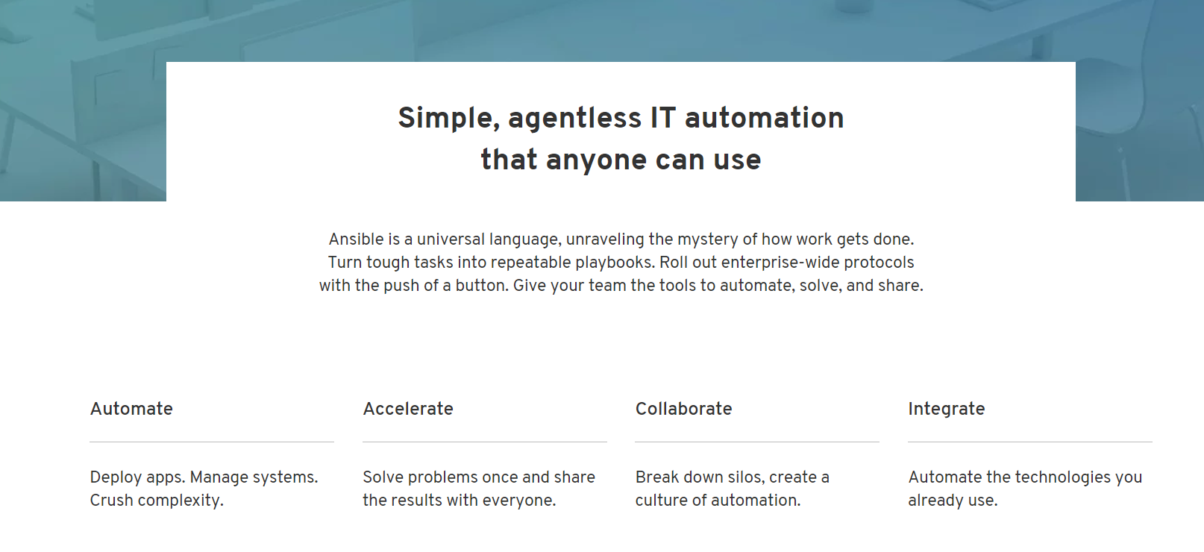
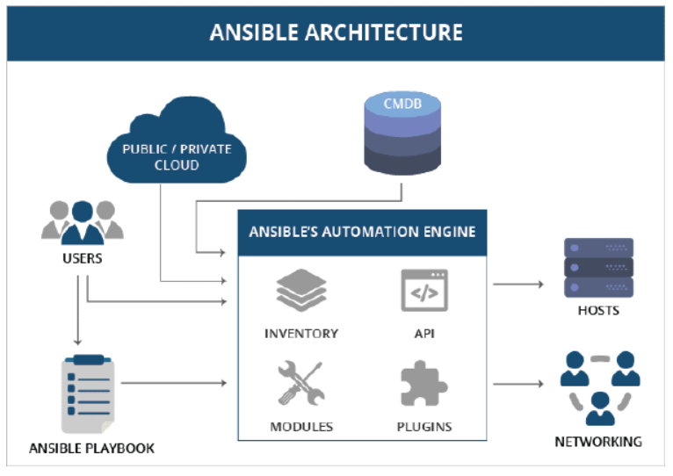
ansible

Slide 22
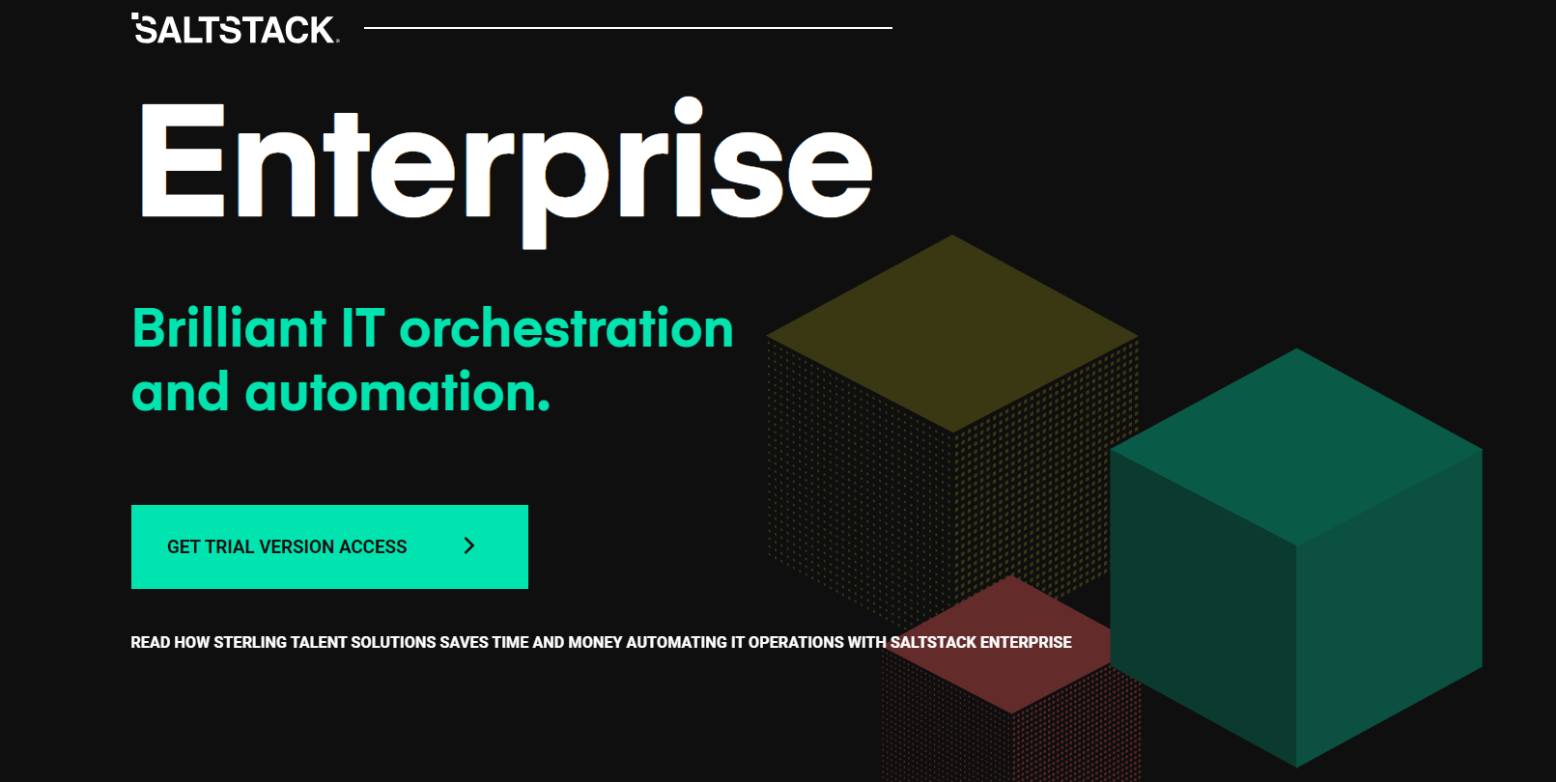
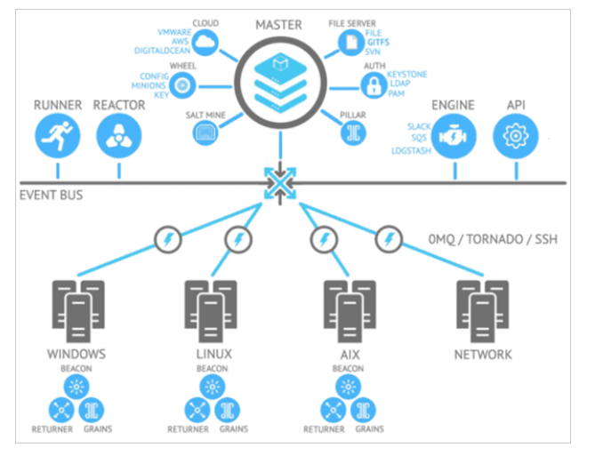
saltstack

Slide 23
REFERENCE: https://www.softwaretestinghelp.com/top-5-software-configuration-management-tools/

